Slide 1
Immediate Processing System on Table
HCI TEAM 5
Kim Doyeon, Kim Hanmin, Jeong Sookyoung, Ha Heonjeong
Client: Dub-bab, Hasi

Slide 2
1
2
3
4
- Introduction
- Our Clients
- Current System
- User classes
- General Tasks
- Usability Goal
- Scenario Design
- Design Iteration
- Low & High Fidelity Design
5
6
7
8
- Formative Evaluation Process
- Quantitative Results
-Usability Problem
- Our Experience
Notes:
Those are contents of our presentation

Slide 3
Introduction
Our project aims to make a system that allows customers order and pay easy and efficiently in restaurants.
For this, we planned to place tablet on each table,
and lead customers order and pay through the tablet.
Notes:
First, I will introduce goal of our project. Our project aims to make a system that allows customers order and pay easy and efficiently in restaurants. For this, we planned to place tablet on each table, and lead customers order and pay through the tablet. System made for this will be introduced later.

Slide 4
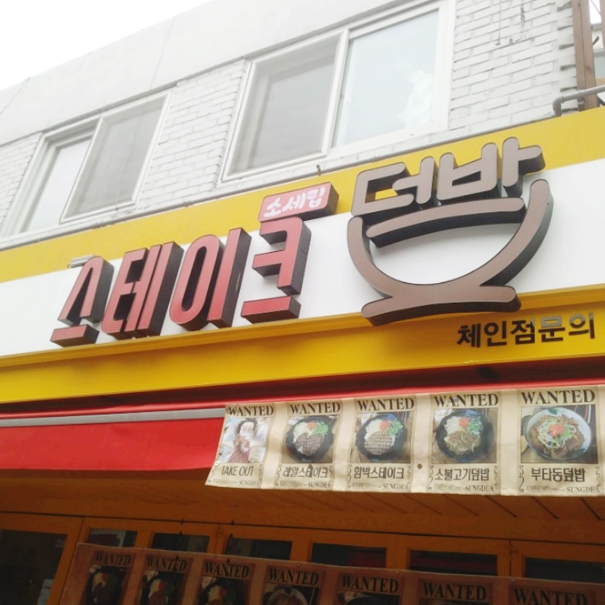
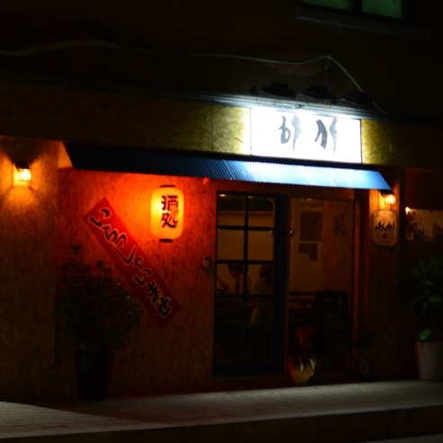
Our Clients
Dub-bab (덮밥의 정석)
Hasi (하시)
Notes:
Our client is Dub-bab and Hasi. Those restaurants are located near SKKU Natural Science campus, and I guess quite a lot of you have been to those eat and drinking place. Some of our team members are acquainted with the owners, so we chose those two restaurants.

Slide 5
Current system
Customers
take a seat
Worker offers menu to customers
Worker takes orders from customers
Worker brings foods to customers
Customers eat
Customers pay the bill on the counter
Line of visibility
Worker enters orders in the POS terminal
Order slip is delivered to kitchen
Cook starts cooking
Cook finishes cooking
Notes:
Current ordering and paying process are like this. Customers take a seat, and worker offers menu and takes order. Then the worker goes to POS terminal and enters orders, and the order slip is delivered to kitchen. After cook finishes cooking, worker brings foods to customers. When customers finishes eating, they go to the counter and pay the bill.
And through our newly developed system, we can shorten this process.

Slide 6
Visits in family unit
Sensitive to taste
Usually parents pay
Student
Local
Resident
University
Employee
User Classes
Split the bill
Sensitive to time and price
Familiar with digitalized things
Sensitive to time and taste
Notes:
We have 3 user classes; student, local resident, and university employee. Student, most important target in both restaurants, has 3 distinctive features. Most of the students split the bill, and they are sensitive to time and price. Also, compared to other user segments, they are more familiar with digitalized things. Local resident usually visits in family unit, and they are sensitive to taste. Unlike student segment, usually parents pay all the bill. Third user class, university employee, are sensitive to time and taste.

Slide 7
Can play mini-games or watch animations until food is ready
Order
Wait
Pay
General Tasks
Can easily figure out whether the food contains one’s preferred and un-preferred ingredients
Can order without waiting worker to come
Can easily split the bill
Can pay without waiting worker to come
Notes:
And those are key tasks that we developed; order, wait and pay. Focusing on order, customers can figure out whether the food contains one’s preferred and un-preferred ingredients easily, which helps them to choose menu. Also, customers can order without waiting worker to come. Also, we made a function for those who spend boring time until food is ready, through mini-games or animations that can be played on tablet. For most of the students who separate the bill, we made process of splitting bill easy. In addition, through paying system, customers do not need to wait for the worker to come when they finished their meal.

Slide 8
Usability Goals
1
Shorten time needed for ordering
2
Shorten time needed for paying
3
Shorten time needed for food to be ready

Slide 9
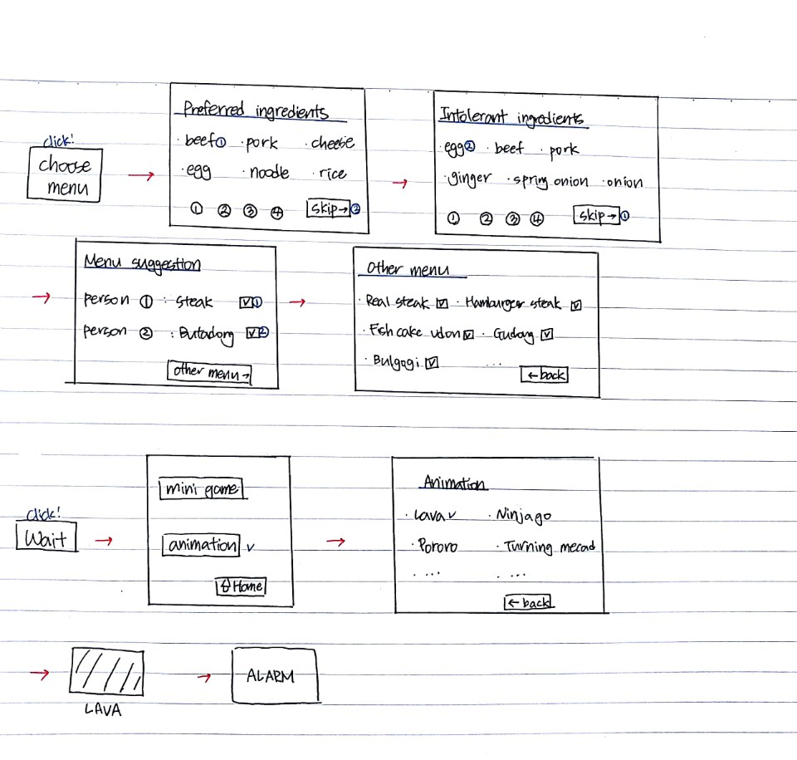
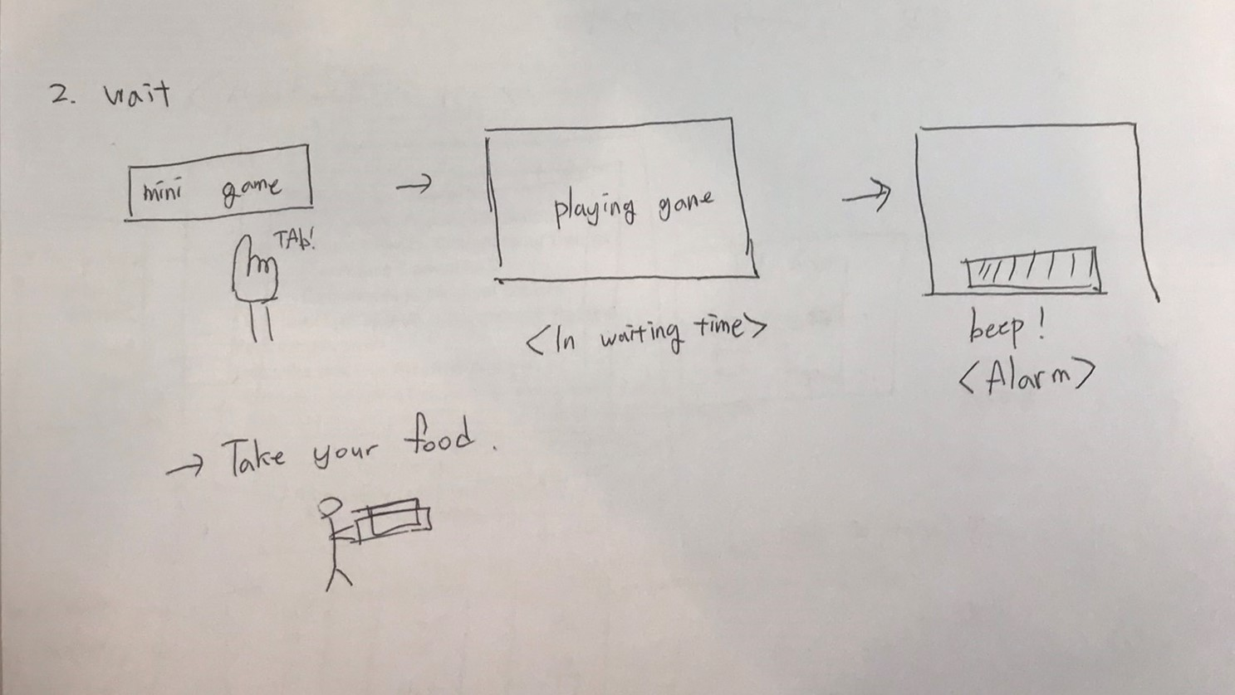
Scenario Design
Scenario 1 design
Scenario 2 design

Slide 10
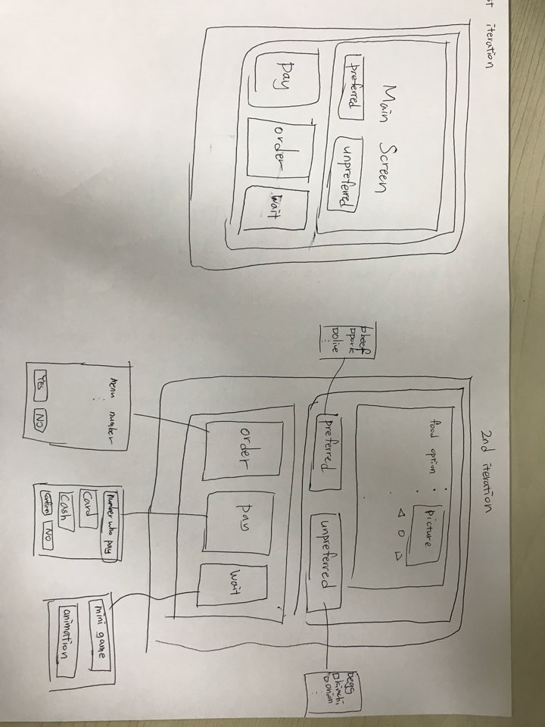
Design Iteration
1st Iteration
2nd Iteration

Slide 11
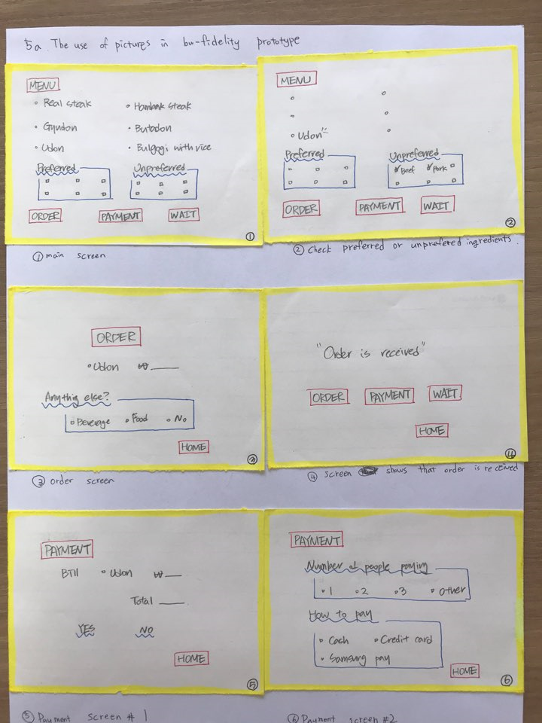
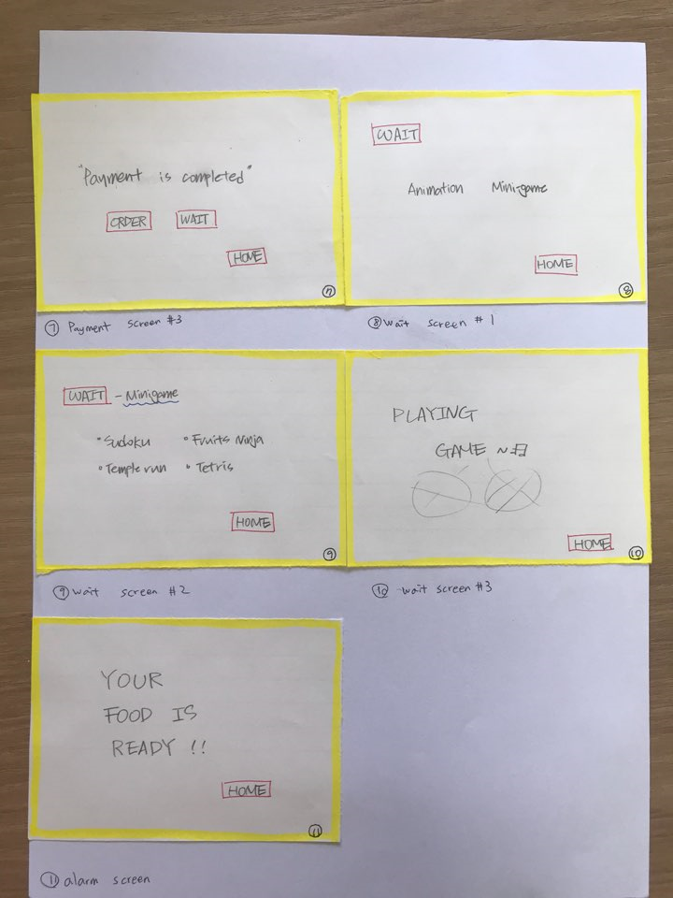
Low Fidelity Design

Slide 12
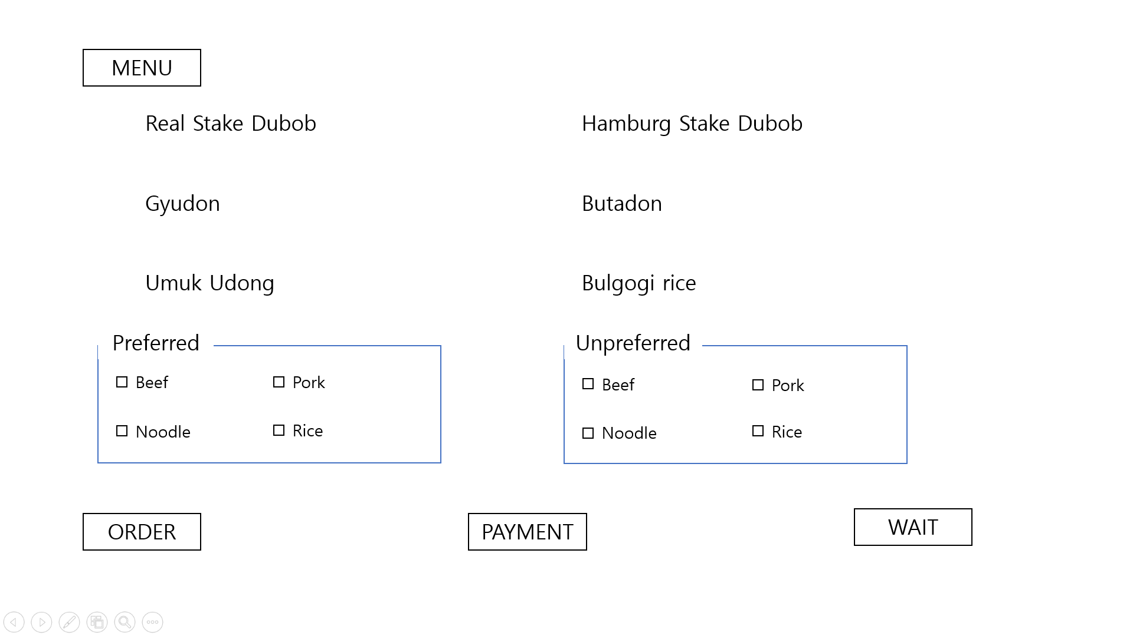
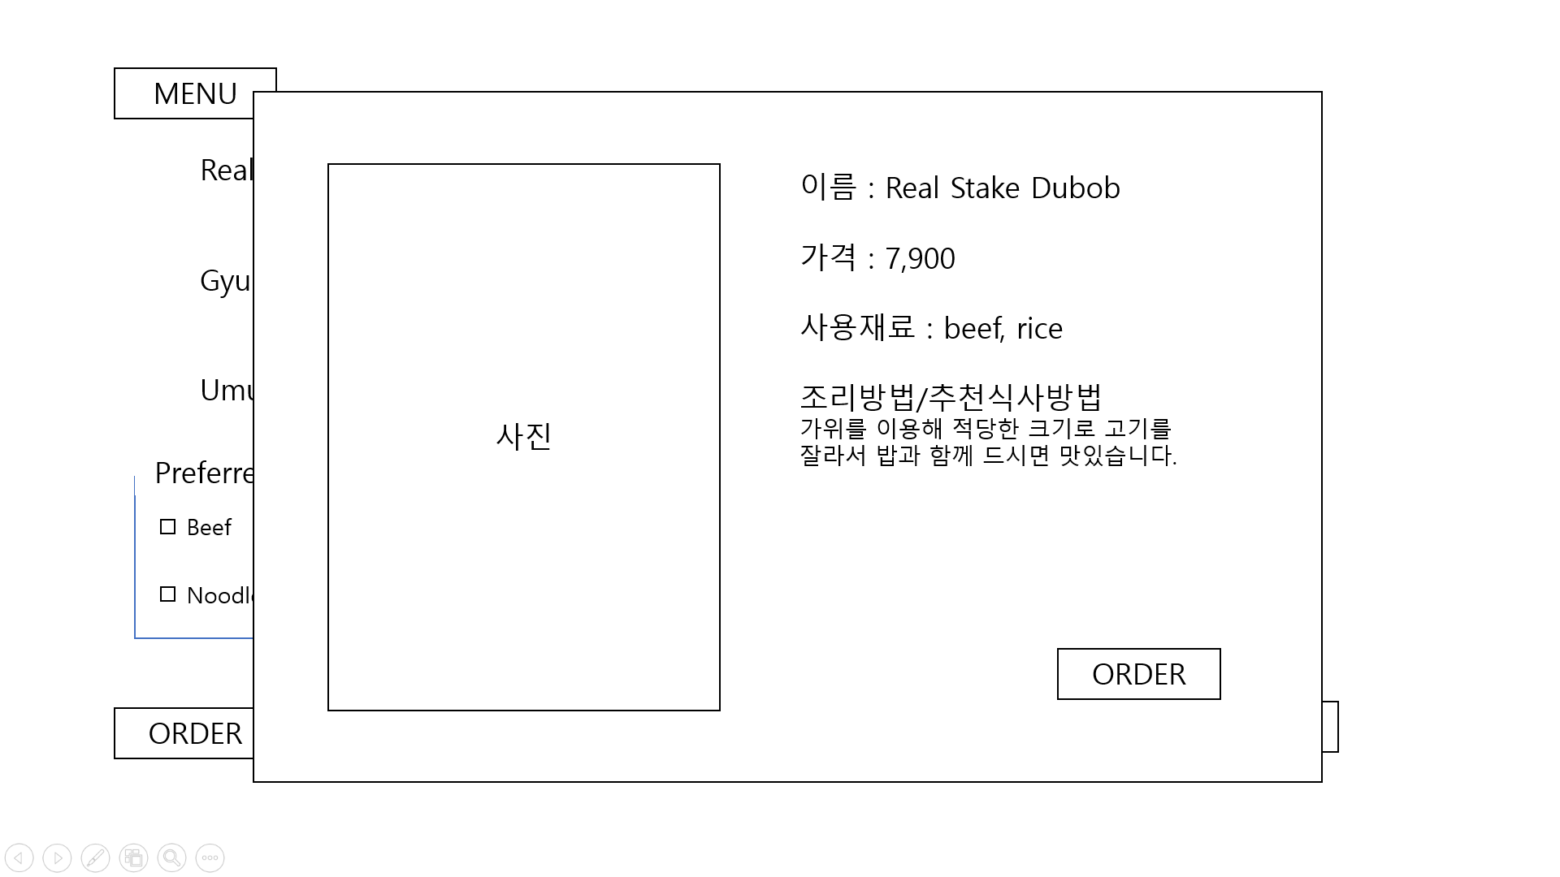
High Fidelity Design : choose menu
Notes:
Finally we developed low – fidelity design to High Fidelity Design
On the food selection screen, you have a menu of foods and made it possible to choose the ingredients you want or want.
If the customer chooses the food menu, the photo, price, ingredients, and how to eat are described.

Slide 13
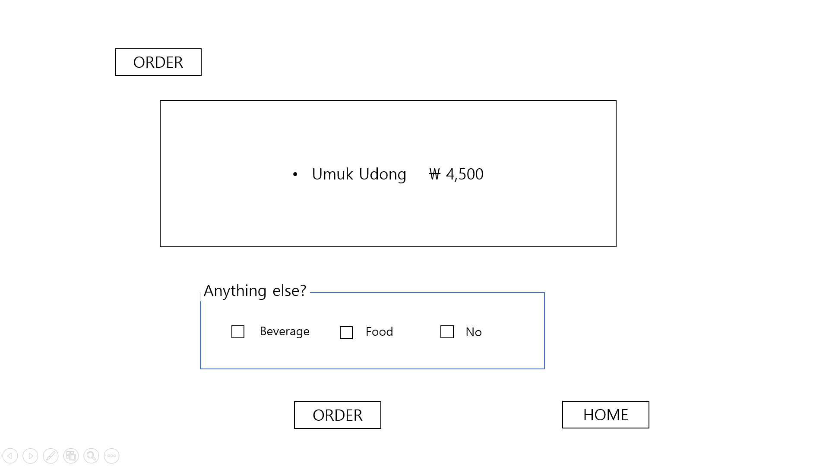
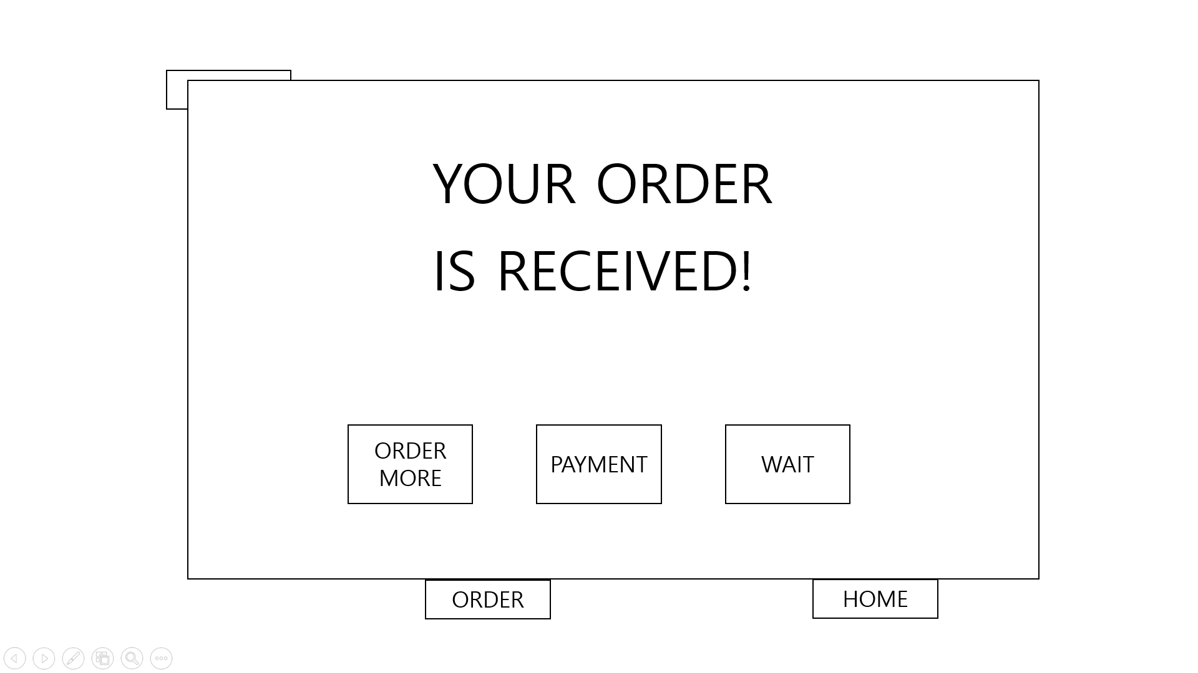
High Fidelity Design : order
Notes:
The ordering screen consists of ordered food items and additional order options.

Slide 14
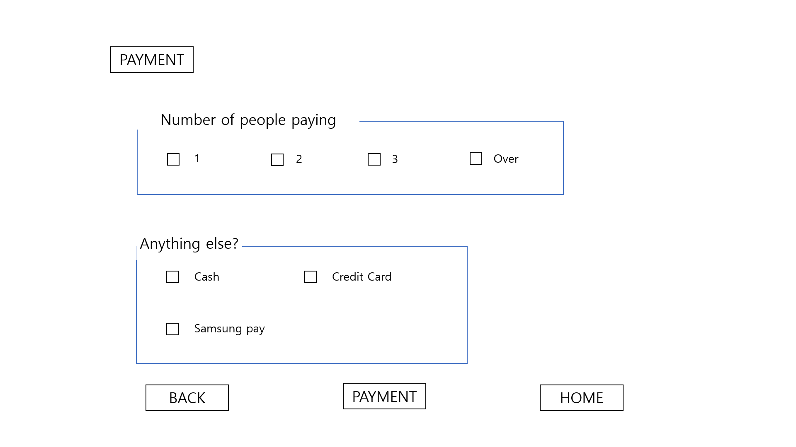
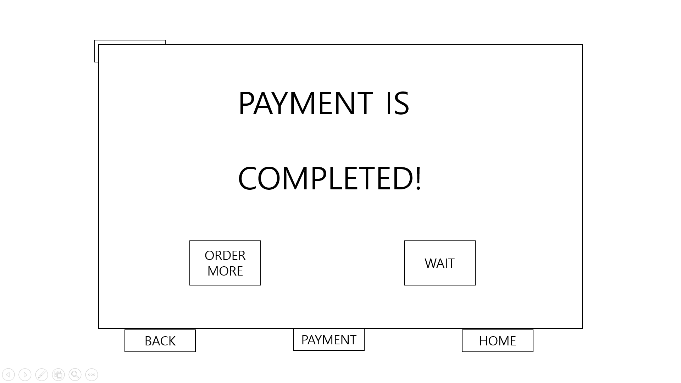
High Fidelity Design : Payment
Notes:
On the Payment screen, decide Number of people paying and the payment method.

Slide 15
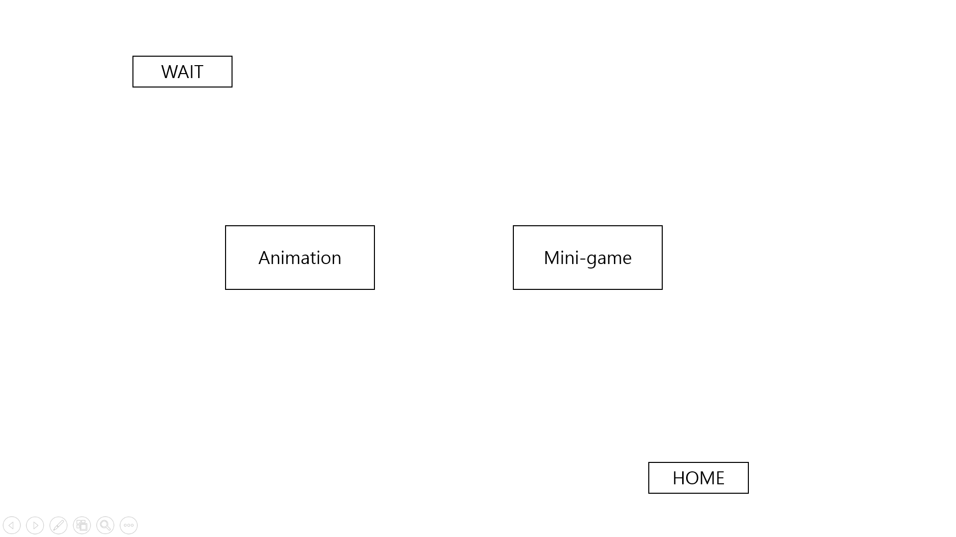
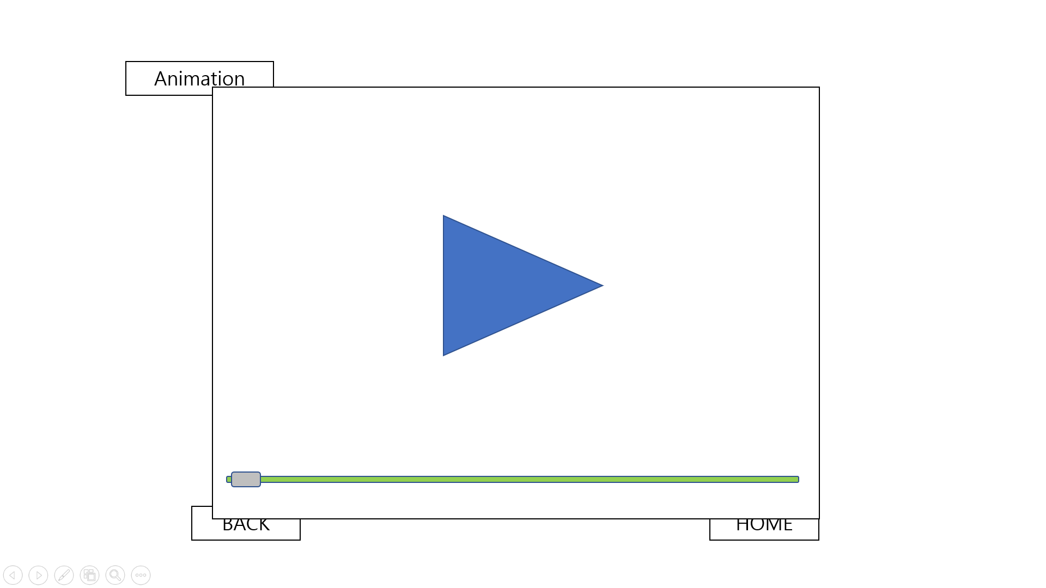
High Fidelity Design : Wait
Notes:
On the wait screen, It consists of content that customers can enjoy while waiting for food such as Animation or mini-game.

Slide 16
High Fidelity Design : Wait
YOUR
FOOD IS
READY!!!
I pick up my food! >>>
HOME
Notes:
On the wait screen, It consists of content that customers can enjoy while waiting for food such as Animation or mini-game.

Slide 17
Formative Evaluation Process
; Participants
In project 4
In project 5 (plan)
 | Job | Gender | Age | Residence
#1 | Student | Male | 23 | Dormitory
#2 | Local | Female | 40 | Apartment
#3 | Doctor | Female | 30 | Dormitory
 | Job | Gender | Age | Residence
#1 | Freeter | Female | 21 | Apartment
#2 | Student | Male | 23 | Studio Apt
#3 | Researcher | Male | 28 | Studio Apt
Represent each user classes, Not from client orgnization
Notes:
Now, I will explain about participants and user specification.
In project 4, we had three participants.
They are not from client organization, so they can represent each user class; Student, Local resident, University employee
We added three participants for Project 5.
Just like a existing participant, they can represent each user class.

Slide 18
Subjective
Metric
Quantitative Results
Satisfaction
Usability attribute | Measuring instrument | Value to be measured | Current level | Target level
Satisfaction (wait) | Questionnaire | Average score | 2 | 4
Satisfaction (choose) | Questionnaire | Average score | 3 | 5
Satisfaction (pay) | Questionnaire | Average score | 3 | 7
Notes:
For a formative evaluation, we use two metric methods.
First one is subjective metric. In this method, we collect subjective satisfaction levels for each task.

Slide 19
Objective
Metric
Quantitative Results
Time
Usability attribute | Measuring instrument | Value to be measured | Current level | Target level
Performance (before the meal begins) | Add app | Time on task | 10min | 8min
Performance(time to ordering) | Add app | Time on task | 60sec | 15sec
Performance (from ordering to receiving alarm) | Add app | Time on task | 7min | 5min
Performance (waiting time to pay) | Add app | Time on task | 1m | 0m
Notes:
Second one is objective metric. We are going to measure the time by three items.
Time to ordering
From ordering to receiving an alarm
Waiting time to pay

Slide 20
Quantitative Results
Participant | Satisfaction 1 | Satisfaction 2 | Satisfaction 3 | Performance 1 | Performance 2 | Performance 3 | Performance 4
1 | 6 | 8 | 9 | 8m | 27s | 7.5m | 33s
2 | 6 | 7 | 7 | 9m | 20s | 6m | 30s
3 | 8 | 7 | 6 | 8m | 45s | 5m | 25s
Notes:
Now, you can show result of three pilot test in Project 4.
The three additional participants will be examined in the same way.

Slide 21
Usability Problem
Separating money function only provides 1/n dividing
Adjusting Food Quantity
Deciding Amount of Money
Missing the Alarm
No additional window adjusting food quantity
Alarm does not include acoustic or haptic feedback
Notes:
I’ introduce some usability problems that occur in proto-test. We find some bugs in our program, also inconvenient factors. We have summarized the frequently mentioned problems. Adjust food quantity, Divide price, and miss alarm.
In our first high-fidelity proto type, there is no button for adjust quantity each menu. If user group wants to order two udong, they must do same order twice. It occurs big inconvenience during ordering process.
So, we will add the function that users can control quantity just click the button.
Our prototype can give opportunities of Dutch pay, but ours is limited. It can provide just 1/n payment, so user can’t change “how much pay”.
We will change the system that can pay not only 1/n, but also user’s input money.
When cook is over, tablet will notice to users by displaying the alarm. Some people say that it forces the users to keep watching the tablet.
Therefore, we will give the alarm by acoustic and haptic way not just visual alarm.

Slide 22
Our Experiences
Interaction with Clients
Specific Designing Process

Slide 23
Thank you

